Slide 1
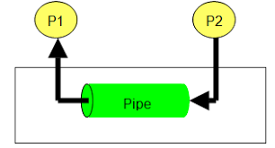
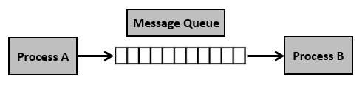
IPC – Pipes and Message Queues

Slide 2
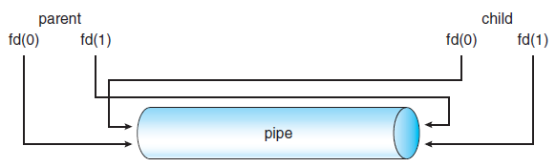
IPC – Pipes and Message Queues
fd(0) – Read End and fd(1) – Write End

Slide 3
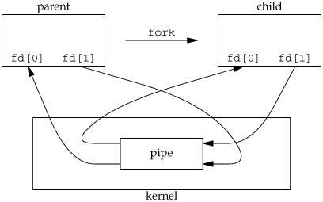
IPC – Pipes : Communication between parent and child
fd(0) – Read End and fd(1) – Write End

Slide 4
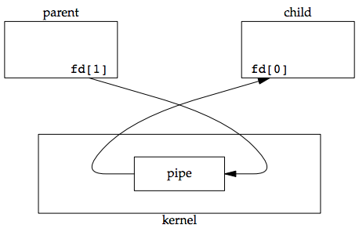
IPC – Pipes : Communication between parent and child
fd(0) – Read End and fd(1) – Write End

Slide 5
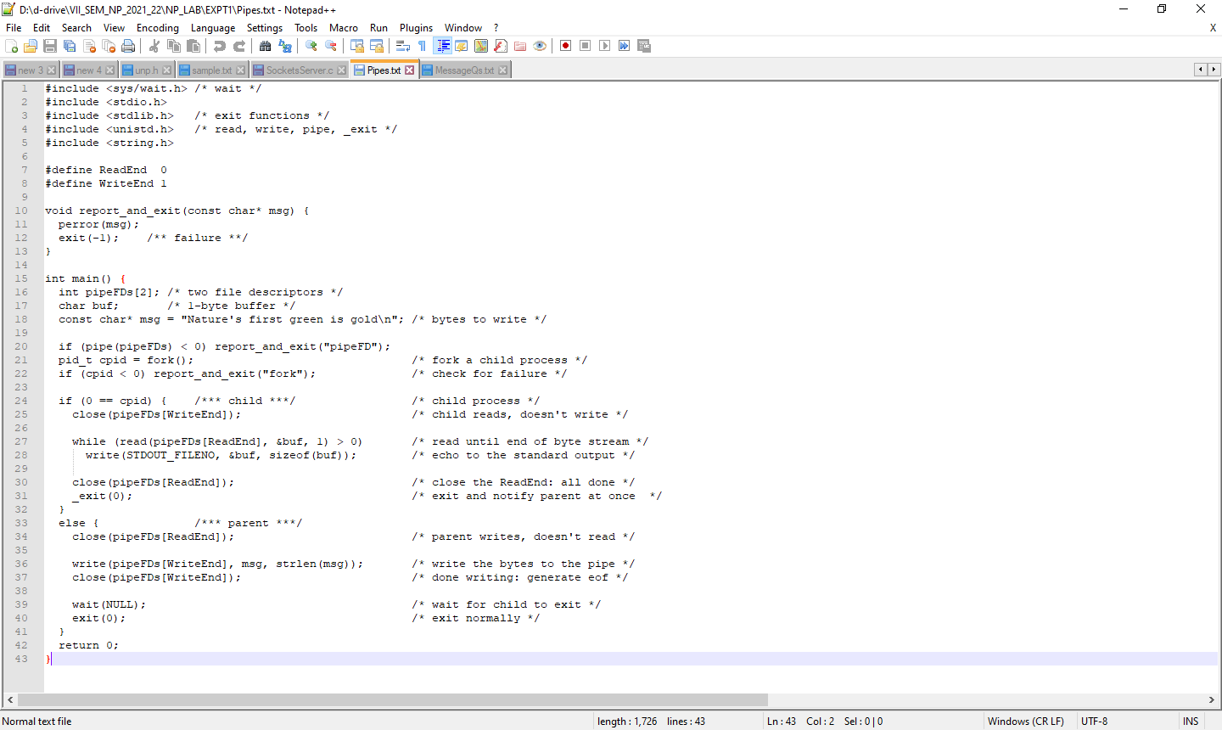
IPC – Pipes : Communication between parent and child

Slide 6
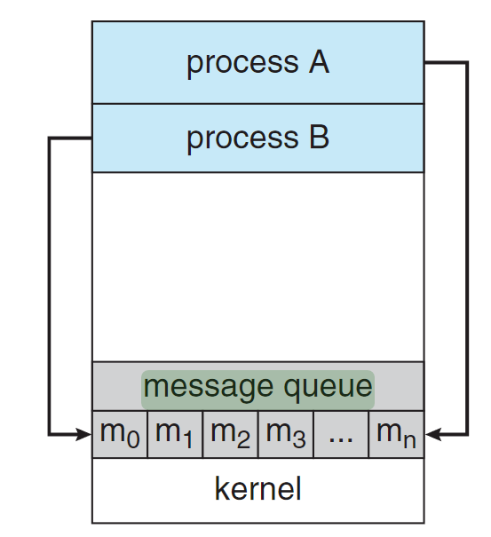
IPC – Message Queues : Communication between Two processes

Slide 7
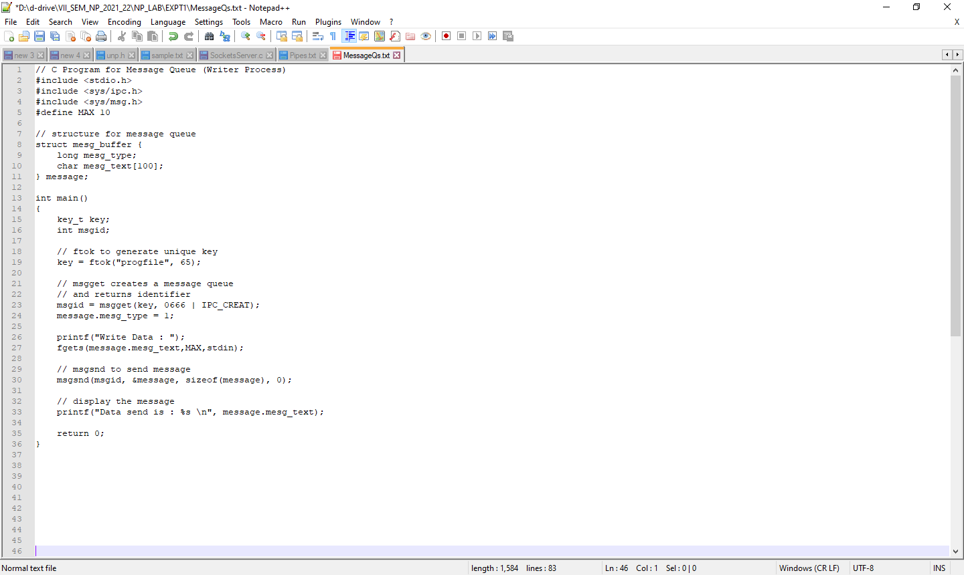
IPC – Message Queues : Communication between Two processes

Slide 8
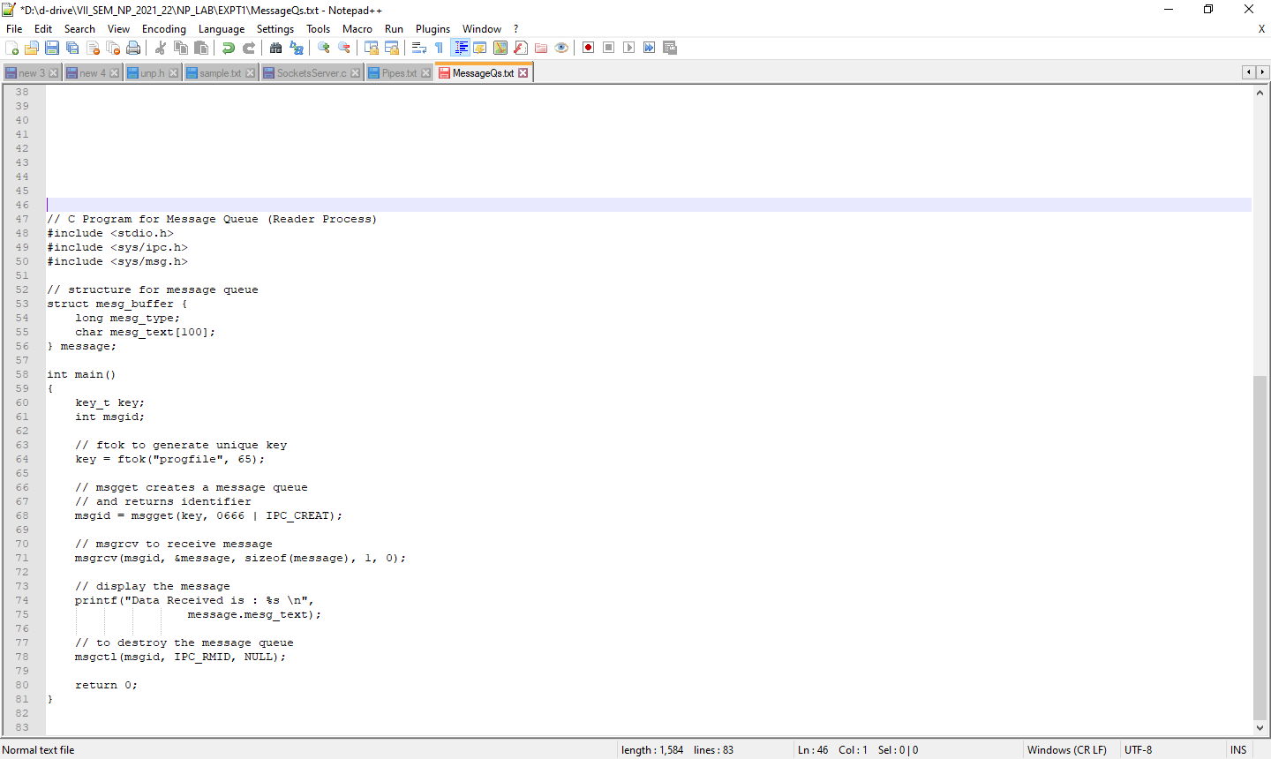
IPC – Message Queues : Communication between Two processes

